Slide 1
Pingmesh: A Large-Scale System for Data Center Network Latency Measurement and Analysis
Chuanxiong Guo, Lihua Yuan, Dong Xiang, Yingnong Dang, Ray Huang, Dave Maltz, Zhaoyi Liu, Vin Wang, Bin Pang, Hua Chen, Zhi-Wei Lin, Varugis Kurien
Microsoft
ACM SIGCOMM 2015
August 18 2015

Slide 2
Outline
Background (Why)
Design and implementation (How)
Latency data analysis (What we get)
Experiences (What we learn)
Related work
Conclusion
Notes:
This is the outline of the talk. I will start from why we do Pingmesh.

Slide 3
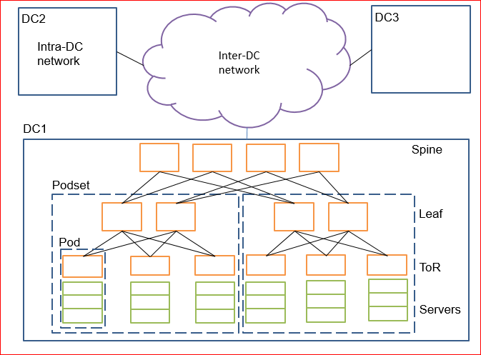
Data center networks (DCN)
Applications/Services
  Search, Storage, Social Networking, IaaS, PaaS, Big data
Networking
  Hardware: Servers, NICs, switches, cables, fibers, transceivers
  Software: NIC firmware, switch software, network protocols, network management and monitoring
A common theme: there are many of them and they all may fail

Slide 4
Challenges for DCN operation
Is this incident caused by the network or not?
  Half of the incidents were not caused by the network
Define and track Network SLA
  What can I expect from the network?
Network troubleshooting
  Which device causes the problem?
  Reduce TTD, TTM, TTR

Slide 5
Pingmesh
Inter-DC
DC_2
DC_1
Inter-DC
Pingmesh
Simple idea: If we know the latency between any two servers, then
Challenges can be addressed:
  If Pingmesh does not see a problem, then it is not a network problem
  Latency data for availability, latency, packet drop rate SLAs
  Network troubleshooting
Multiple levels of complete graphs
DC_k
Intra-DC
TOR_1
Intra-Pod
TOR_n
TOR_2
Server_1
Server_2
TOR_n
TOR_3
Server_m

Slide 6
Outline
Background
Pingmesh design and implementation
Latency data analysis
Experiences
Related work
Conclusion
Notes:
Next, I will introduce the design and implementation of Pingmesh.

Slide 7
Pingmesh design
Data Storage and Analysis
(DSA)
Pingmesh Controller
Visuali-zation
Alert
Pingmeshgenerator
Network graph
Web service
PA pipeline
Perfcounter Aggregator
Database
Pinglist.xml
vip
Pingmesh Agent
SCOPE Jobs
Server
Server
TCP/HTTP
probings
Pingmesh agent
Pingmesh agent
Cosmos Store
log
log
vip
Cosmos pipeline

Slide 8
Pingmesh implementation
Built on top of existing infrastructure and services
  Autopilot, Cosmos/SCOPE
Pingmesh Agent
  Safe, light-weight, low overhead
  A Pingmesh agent may probe 4500+ peers
Pingmesh Controller
  Geo replicated
  SLB for load-balancing and failure handling
Data Storage and Analysis
  Autopilot PerfCounter Aggregator for counters aggregation
  Cosmos/SCOPE for data storage and processing
  10min, 1hour, 1day jobs

Slide 9
Outline
Background
Pingmesh design and implementation
Latency data analysis
  DCN latency study
  Silent packet drop detection
Experiences
Related work
Conclusion

Slide 10
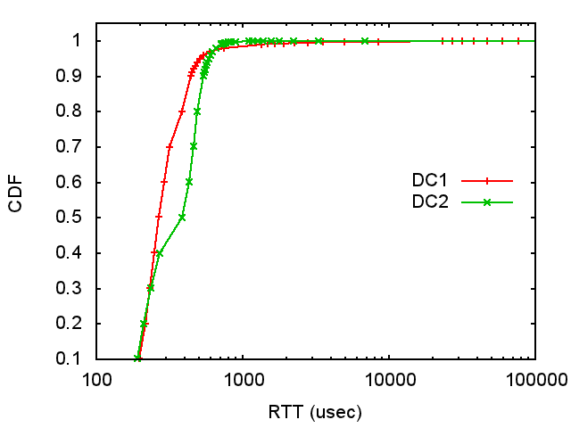
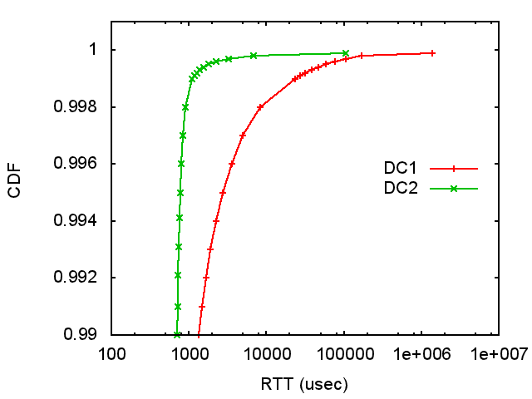
Network latency study
DC1: Cosmos
DC2: Bing

Slide 11
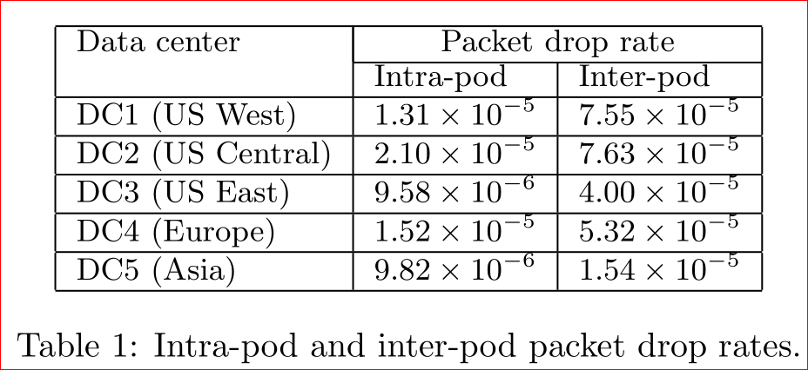
Packet drops
Intra-pod: packet drops at ToR and NIC
Inter-pod: more hops, more drops
“Normal” drop rate: 10^-4-10^-5

Slide 12


Packet blackhole
Causes of blackhole
  TCAM deficits, e.g., parity errors
  ECMP entry errors due to software bug
  RIB FIB mismatch
  Unknown reasons
Can be fixed by switch reload
Blackhole: Deterministic packet drops
Switch
(sip1, dip1)
(sip2, dip1)
(sip1, sport1,dip1,dport1,tcp)
(sip1, sport2,dip1,dport1,tcp)

Slide 13
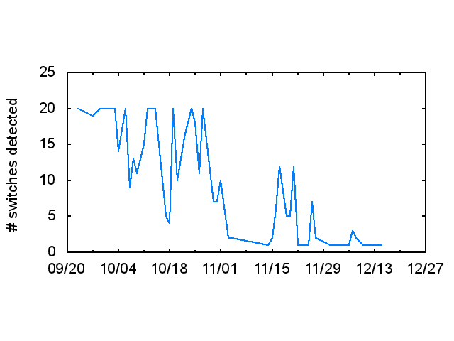
Packet blackhole detection
ToR blackhole detection algorithm:
For each server as destination, calculate if it is affected by blackhole
For each ToR, assign a ratio, which is the number of underneath servers affected by blackhole divided by the total server number
If the ratio exceeds a threshold, the switch becomes a blackhole candidate
800+ ToR switches detected and fixed in one year
Network incidents because of ToR blackhole eliminated

Slide 14
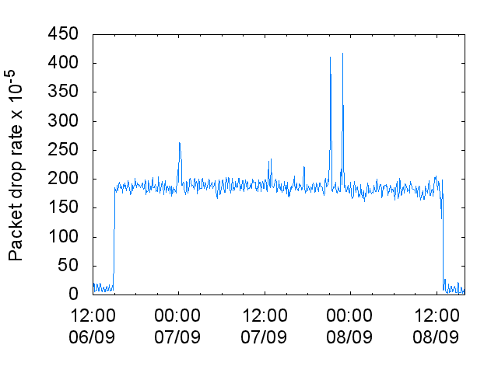
Silent random packet drops
Silent, nondeterministic, random packet drops
Due to
  Switch fabric SERDES CRC error
  Linecard not well seated
  Faulty/aging switching ASICs
  Reasons unknown
Hard to detect: because they are silent
Pingmesh makes detection simple

Slide 15
Outline
Background
Pingmesh design and implementation
Latency data analysis
Experiences
Related work
Conclusion
Notes:
In what follows, we share what we have learned in building and running Pingmesh.

Slide 16
Experiences
Pingmesh as a full coverage and always-on service
  RCA and forensic
  Proactive vs. reactive
Loosely coupled design for evolvement
  Many new features added: Qos monitoring, VIP monitoring, silent packet drop detection, network metrics for applications
Visualization for pattern recognition

Slide 17
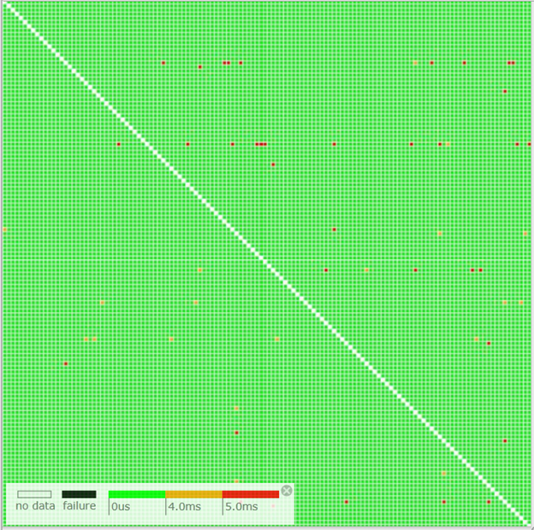
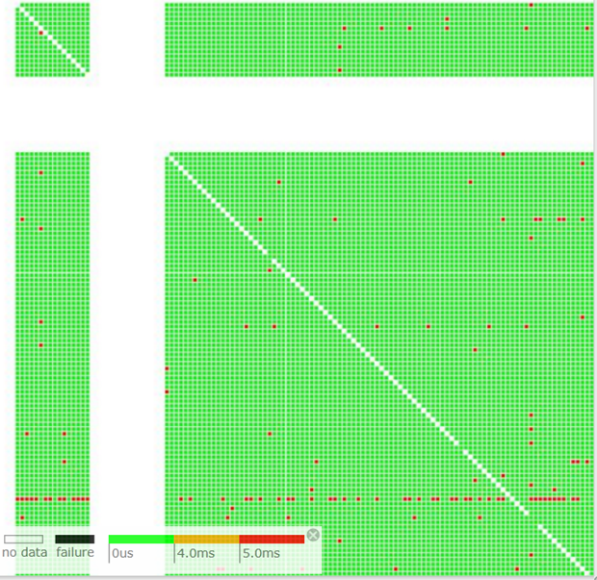
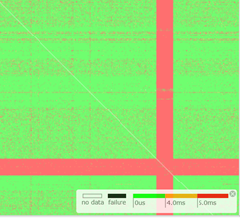
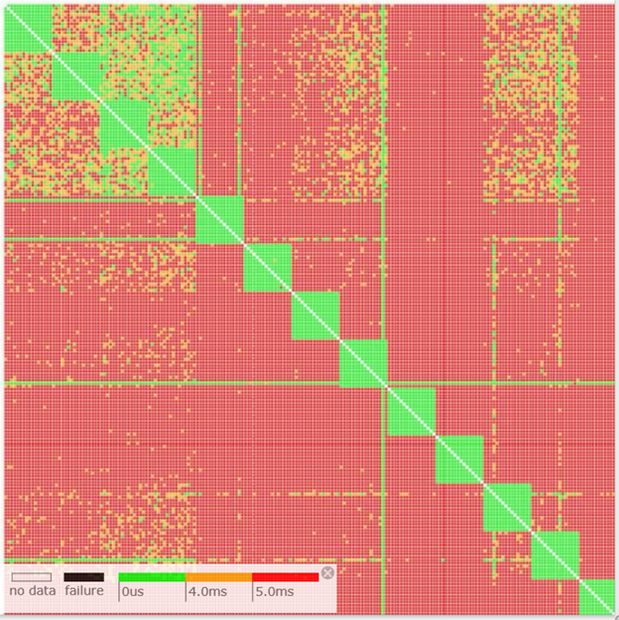
Visualization for pattern detection
Normal
Podset down
Podset failure
Spine failure

Slide 18
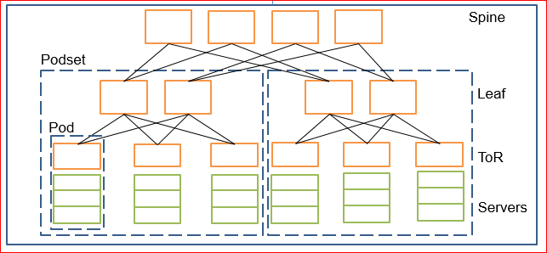
Visualization for pattern detection

Slide 19
Limitations
Pingmesh cannot tell which spine switch is dropping packets
Single packet based RTT measurement cannot reveal TCP parameter configuration bugs

Slide 20
Related work
Network traffic pattern studies [6,21]
Cisco IPSLA
Google backbone monitoring
Everflow, NetSight for packet tracing
ATPG for active probing

Slide 21
Conclusion
A simple idea at scale: Measuring network latency between any two servers
  Provides both macro and micro views of the network
  Network SLA definition and tracking
  Gray network failure detection
Pingmesh has been running in Microsoft data centers for near 5 years
  Produces 24TB latency data and 200B+ probes per day

Slide 22
Q&A

Slide 23
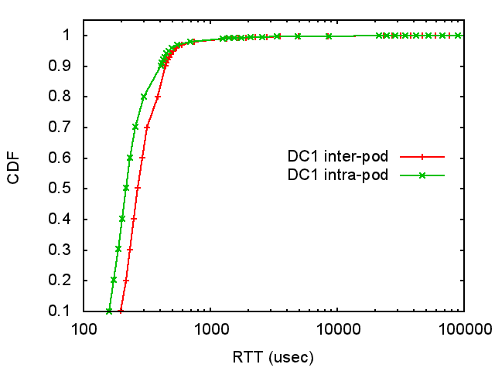
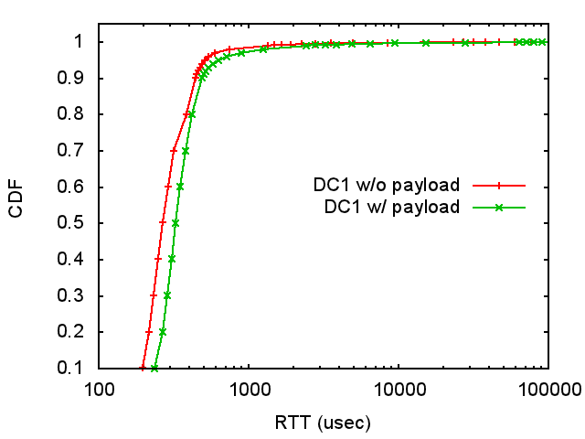
Network latency study

