Slide 1

RDMA over Commodity Ethernet at Scale
Chuanxiong Guo, Haitao Wu, Zhong Deng, Gaurav Soni,
Jianxi Ye, Jitendra Padhye, Marina Lipshteyn
ACM SIGCOMM 2016
August 24 2016

Slide 2
Outline
RDMA/RoCEv2 background
DSCP-based PFC
Safety challenges
RDMA transport livelock
PFC deadlock
PFC pause frame storm
Slow-receiver symptom
Experiences and lessons learned
Related work
Conclusion

Slide 3
RDMA/RoCEv2 background
RDMA addresses TCP’s latency and CPU overhead problems
RDMA: Remote Direct Memory Access
RDMA offloads the transport layer to the NIC
RDMA needs a lossless network
RoCEv2: RDMA over commodity Ethernet
DCQCN for connection-level congestion control
PFC for hop-by-hop flow control
RDMA app
RDMA app
User
RDMA verbs
RDMA verbs
TCP/IP
TCP/IP
Kernel
NIC driver
NIC driver
RDMA transport
RDMA transport
DMA
DMA
Hardware
IP
IP
Ethernet
Ethernet
Lossless network

Slide 4
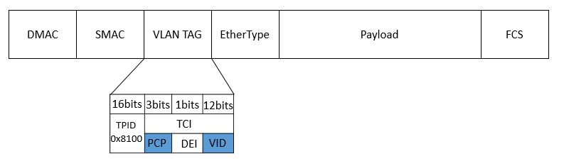

Priority-based flow control (PFC)
Egress port
Ingress port
Data packet
Hop-by-hop flow control, with eight priorities for HOL blocking mitigation
The priority in data packets is carried in the VLAN tag
PFC pause frame to inform the upstream to stop
p0
p0
p0
p1
p1
p1
p7
PFC pause frame
p7
XOFF threshold
Data packet
PFC pause frame

Slide 5
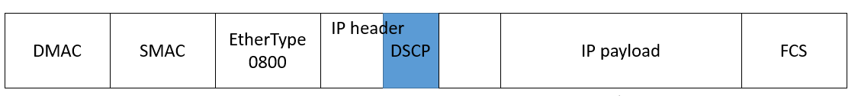
DSCP-based PFC
TOR Switch
Issues of VLAN-based PFC
It breaks PXE boot
No standard way for carrying VLAN tag in L3 networks
DSCP-based PFC
DSCP field for carrying the priority value
No change needed for the PFC pause frame
Supported by major switch/NIC venders
Trunk mode
NIC
No VLAN tag when PXE boot
Data packet
PFC pause frame

Slide 6
Outline
RDMA/RoCEv2 background
DSCP-based PFC
Safety challenges
RDMA transport livelock
PFC deadlock
PFC pause frame storm
Slow-receiver symptom
Experiences and lessons learned
Related work
Conclusion

Slide 7
RDMA transport livelock
Receiver
Sender
Receiver
Sender
RDMA Send 0
RDMA Send 0
Switch
RDMA Send 1
RDMA Send 1
Pkt drop rate 1/256
RDMA Send N+1
RDMA Send N+1
Sender
Receiver
RDMA Send N+2
RDMA Send N+2
NAK N
NAK N
RDMA Send 0
RDMA Send N
RDMA Send 1
RDMA Send N+1
RDMA Send 2
RDMA Send N+2
Go-back-0
Go-back-N

Slide 8
PFC deadlock
Our data centers use Clos network
Packets first travel up then go down
No cyclic buffer dependency for up-down routing -> no deadlock
But we did experience deadlock!
Spine
Podset
Leaf
Pod
ToR
Servers

Slide 9
PFC deadlock
Preliminaries
ARP table: IP address to MAC address mapping
MAC table: MAC address to port mapping
If MAC entry is missing, packets are flooded to all ports
Input
ARP table
IP | MAC | TTL
IP0 | MAC0 | 2h
IP1 | MAC1 | 1h
MAC table
MAC | Port | TTL
MAC0 | Port0 | 10min
MAC1 | - | -
Dst: IP1
Output

Slide 10
PFC deadlock
Path: {S1, T0, La, T1, S3}
La
Lb
Path: {S1, T0, La, T1, S5}
p0
p1
p0
p1
Path: {S4, T1, Lb, T0, S2}
PFC pause frames
2
3
1
4
Congested port
p2
p3
p3
p4
Ingress
port
T0
T1
p0
p1
p0
p1
p2
Egress
port
Dead server
Packet drop
PFC pause frames
Server
S1
S2
S3
S4
S5

Slide 11
PFC deadlock
The PFC deadlock root cause: the interaction between the PFC flow control and the Ethernet packet flooding
Solution: drop the lossless packets if the ARP entry is incomplete
Recommendation: do not flood or multicast for lossless traffic
Call for action: more research on deadlocks

Slide 12
NIC PFC pause frame storm
A malfunctioning NIC may block the whole network
PFC pause frame storms caused several incidents
Solution: watchdogs at both NIC and switch sides to stop the storm
Spine layer
Podset 0
Podset 1
Leaf layer
ToRs
0
1
2
3
4
5
6
7
servers
Malfunctioning NIC

Slide 13
The slow-receiver symptom
ToR to NIC is 40Gb/s, NIC to server is 64Gb/s
But NICs may generate large number of PFC pause frames
Root cause: NIC is resource constrained
Mitigation
Large page size for the MTT (memory translation table) entry
Dynamic buffer sharing at the ToR
Server
CPU
DRAM
PCIe
Gen3 8x8 64Gb/s
QSFP
40Gb/s
WQEs
MTT
ToR
QPC
NIC
Pause frames

Slide 14
Outline
RDMA/RoCEv2 background
DSCP-based PFC
Safety challenges
RDMA transport livelock
PFC deadlock
PFC pause frame storm
Slow-receiver symptom
Experiences and lessons learned
Related work
Conclusion

Slide 15
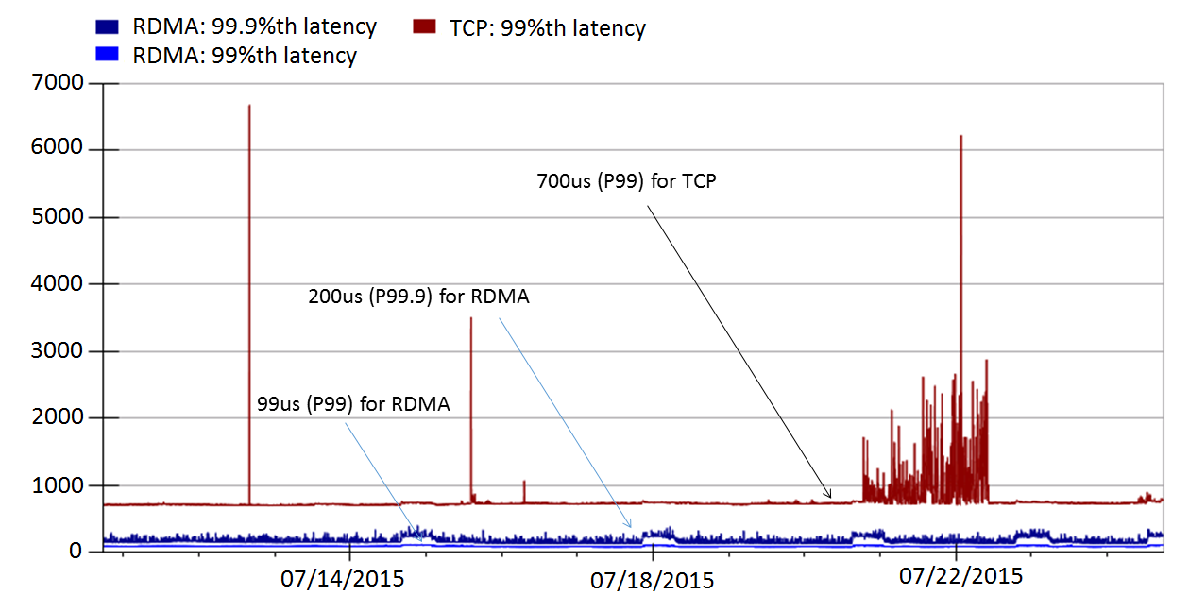
Latency reduction
RoCEv2 deployed in Bing world-wide for one and half years
Significant latency reduction
Incast problem solved as no packet drops

Slide 16
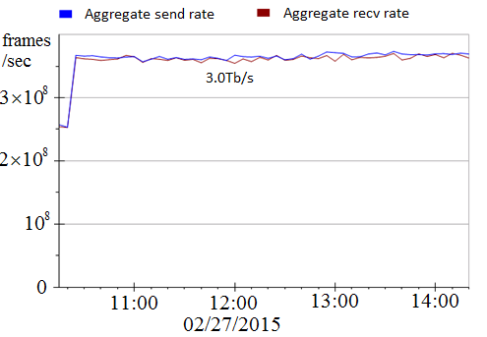
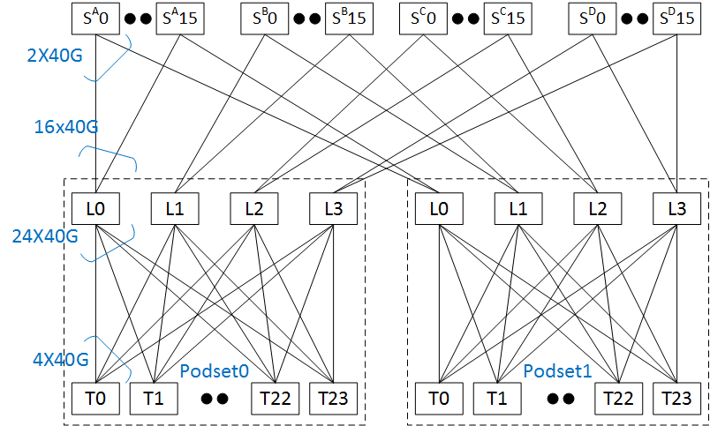
RDMA throughput
Using two podsets each with 500+ servers
5Tb/s capacity between the two podsets
Achieved 3Tb/s inter-podset throughput
Bottlenecked by ECMP routing
Close to 0 CPU overhead

Slide 17
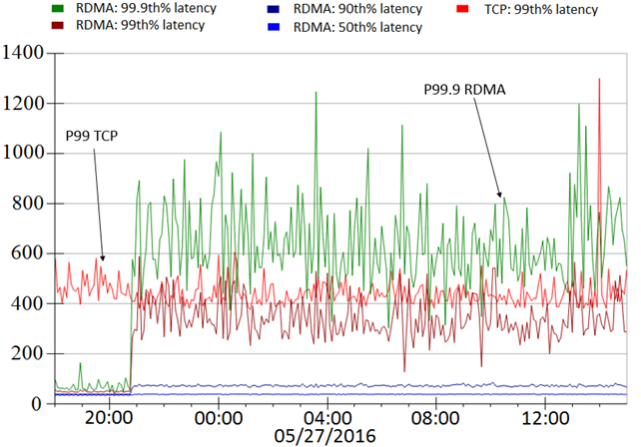
Latency and throughput tradeoff
us
L0
L1
L1
L1
T0
T1
S0,0
S0,23
S1,0
S1,23
RDMA latencies increase as data shuffling started
Low latency vs high throughput
Before data shuffling
During data shuffling

Slide 18
Lessons learned
Deadlock, livelock, PFC pause frames propagation and storm did happen
Be prepared for the unexpected
Configuration management, latency/availability, PFC pause frame, RDMA traffic monitoring
NICs are the key to make RoCEv2 work
Loss vs lossless: Is lossless needed?

Slide 19
Related work
Infiniband
iWarp
Deadlock in lossless networks
TCP perf tuning vs. RDMA

Slide 20
Conclusion
RoCEv2 has been running safely in Microsoft data centers for one and half years
DSCP-based PFC which scales RoCEv2 from L2 to L3
Various safety issues/bugs (livelock, deadlock, PFC pause storm, PFC pause propagation) can all be addressed
Future work
RDMA for inter-DC communications
Understanding of deadlocks in data centers
Lossless, low-latency and high-throughput networking
Applications adoption

